Slide 1

Parts and assemblies engineering Lab-2
Denis Dukhnovskiy and Olga Rod

Slide 2
The task
rib
Design the overlap joint (rivet) between two stringers and the rib
The goals of task:
Determine the number of rivets
Calculate the diameter of rivet
And determine the overlap joint position between two stringers and rib with pad
Determine the thickness and dimensions of pad
stringer
pad
B
A
B
A
skin

Slide 3

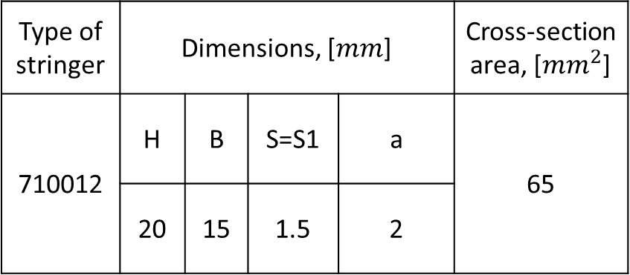
Task guide
1. Choose the task variant and obtain maximum tensile load for stringer:
$P_{max⁡_str}=A_{str}∙σ_{B_str}$ or $P_{max⁡_str}=P∙1.3$
2. Choose the materials of stringers, pad and skin
Type of stringer | Dimensions, [$mm$] |  |  |  | Cross-section area, [${mm}^{2}$]
710012 | H | B | S=S1 | a | 65
 | 20 | 15 | 1.5 | 2
 | Variants
Variants | 1 | 2 | 3 | 4
Type of stringers | 710010 | 710003 | 710020 | 710012
P, N | 1350 | 1000 | 1900 | 2400

Slide 4
Task guide
Table – Variants of Task
 | Variants
Variants | 1 | 2 | 3 | 4 | 5 | 6 | 7
Type of stringers | 710010 | 710003 | 710020 | 710012 | 420069 | 420075 | 710017
P, N | 1350 | 1000 | 1900 | 2400 | 2700 | 3800 | 2300

Slide 5


Task guide
3. Preliminary diameter of rivet calculate by equation:
$d_{rivet}=2\sqrt{t_{total}}$, where $t_{total}=t_{str}+$ $t_{skin}+t_{pad}$
$t_{str}$= S or S1 - thickness of stringer, $t_{skin}$ - thickness of skin, $t_{pad}$ - thickness of pad
For preliminary calculation thickness of skin and pad equal 1.5 mm
$$d_{rivet}$$

Slide 6
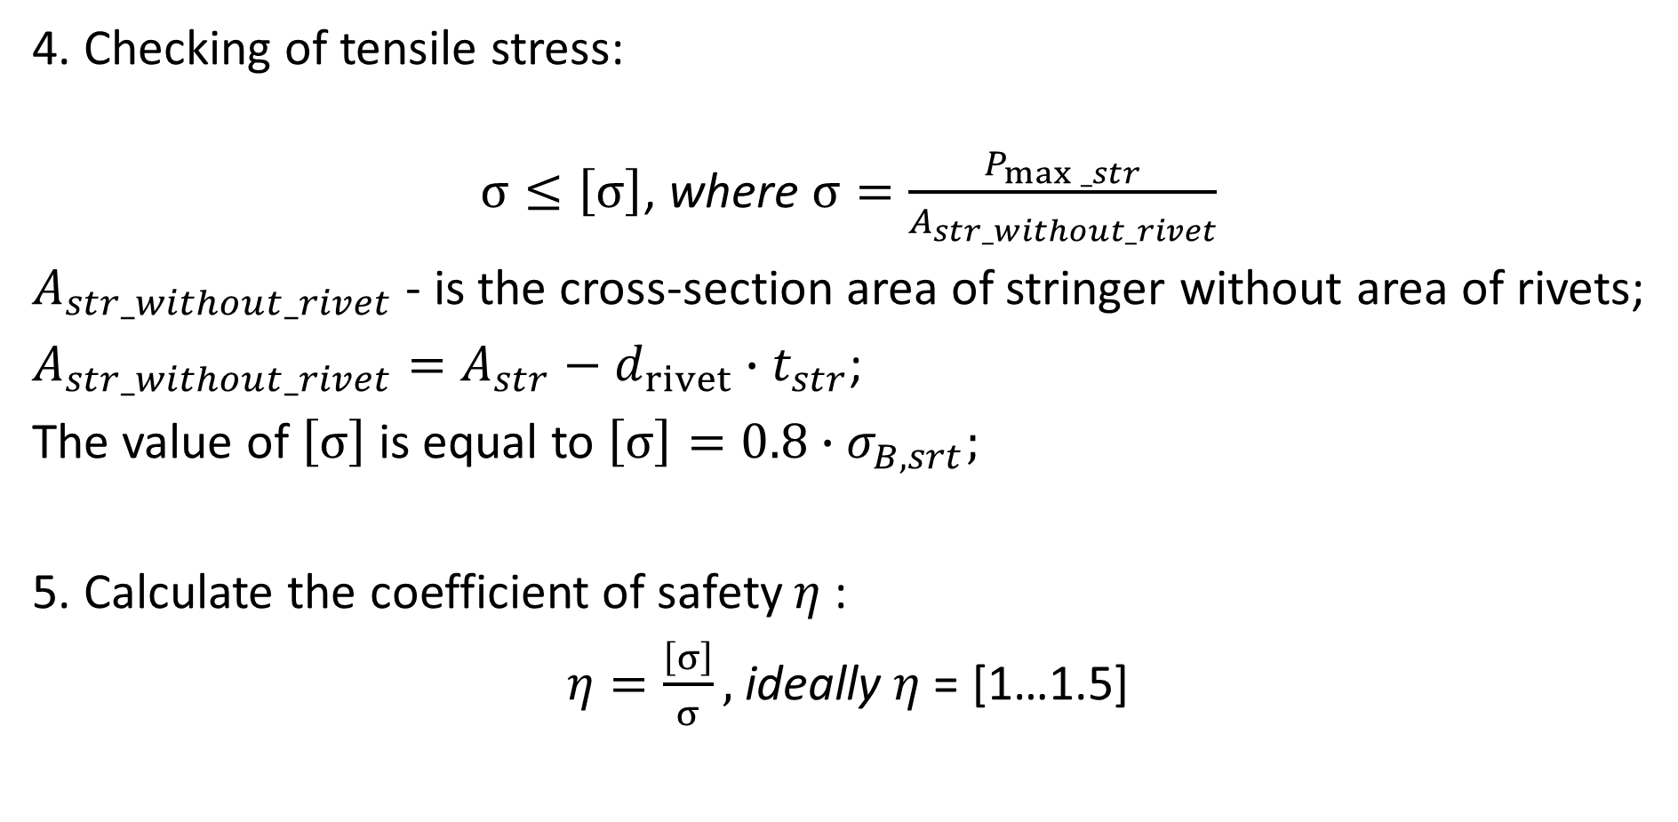
Task guide
4. Checking of tensile stress:
$σ≤\left[σ\right]$, where $σ=\frac{P_{max⁡_str}}{A_{str_without_rivet}}$
$A_{str_without_rivet}$ - is the cross-section area of stringer without area of rivets;
$A_{str_without_rivet}=A_{str}−d_{rivet}∙t_{str}$;
The value of $\left[σ\right]$ is equal to $\left[σ\right]=0.8∙σ_{B,srt};$
5. Calculate the coefficient of safety $η$ :
$η=\frac{\left[σ\right]}{σ},$ideally $η$ = [1…1.5]

Slide 7
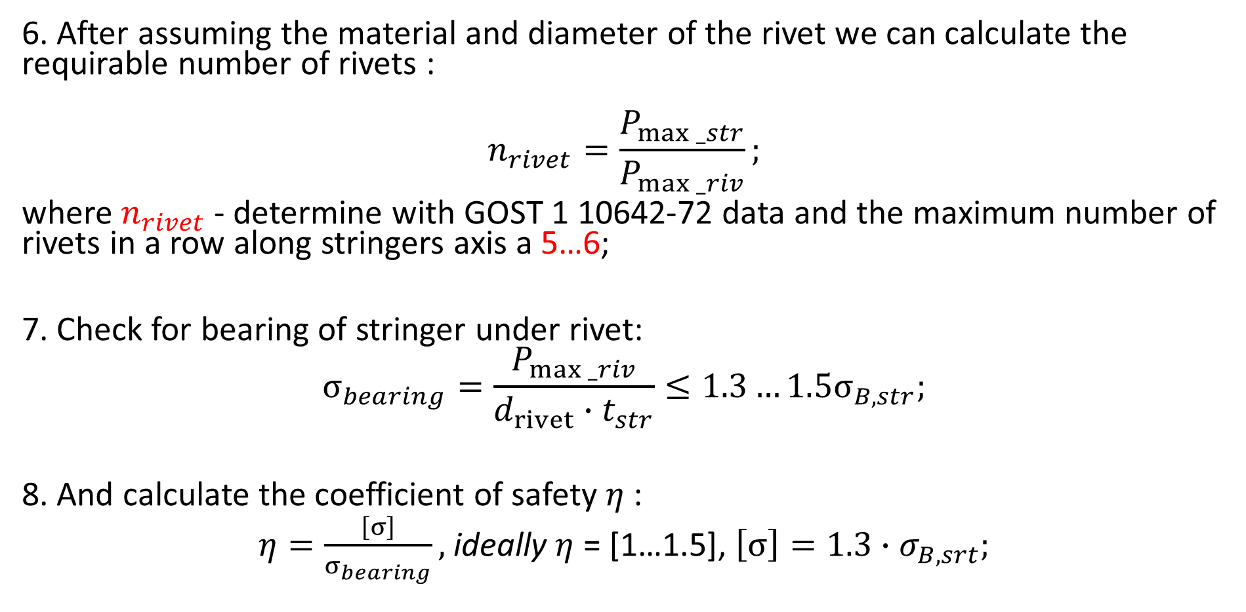
Task guide
6. After assuming the material and diameter of the rivet we can calculate the requirable number of rivets :
$$n_{rivet}=\frac{P_{max⁡_str}}{P_{max⁡_riv}};$$
where$n_{rivet}$ - determine with GOST 1 10642-72 data and the maximum number of rivets in a row along stringers axis a 5…6;
7. Check for bearing of stringer under rivet:
$$σ_{bearing}=\frac{P_{max⁡_riv}}{d_{rivet}∙t_{str}}≤1.3…1.5σ_{B,str};$$
8. And calculate the coefficient of safety $η$ :
$η=\frac{\left[σ\right]}{σ_{bearing}},$ideally $η$ = [1…1.5], $\left[σ\right]=1.3∙σ_{B,srt};$

Slide 8

Task guide
9. Checking the edge distance m for cutting failure:
$$2∙d_{rivet}≤m≤2∙d_{rivet}+2;$$
10. Calculate the actual shear stresses of the edge:
$$τ_{act}=\frac{P_{max⁡_riv}}{2∙m∙t_{str}}<τ_{B};$$
Where $τ_{B}=(0.6…065)∙$ $σ_{B,str}$;

Slide 9
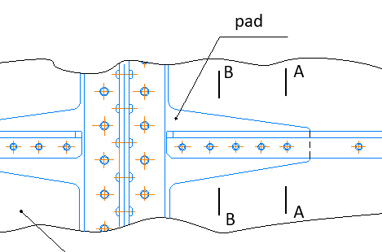
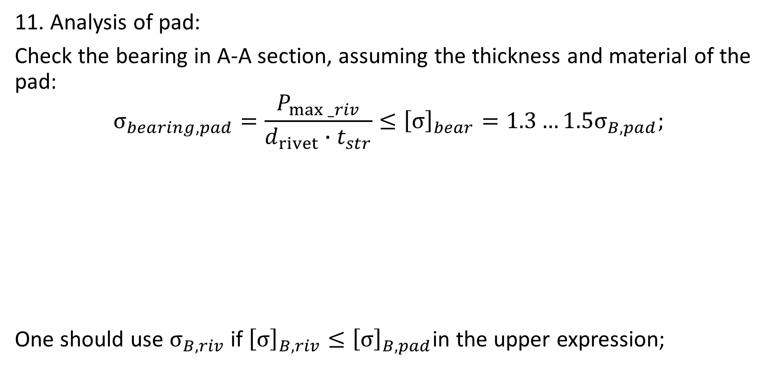
Task guide
11. Analysis of pad:
Check the bearing in A-A section, assuming the thickness and material of the pad:
$$σ_{bearing, pad}=\frac{P_{max⁡_riv}}{d_{rivet}∙t_{str}}≤{\left[σ\right]}_{bear}=1.3…1.5σ_{B,pad};$$
One should use $σ_{B, riv}$ if ${\left[σ\right]}_{B,riv}≤{\left[σ\right]}_{B,pad}$in the upper expression;

Slide 10
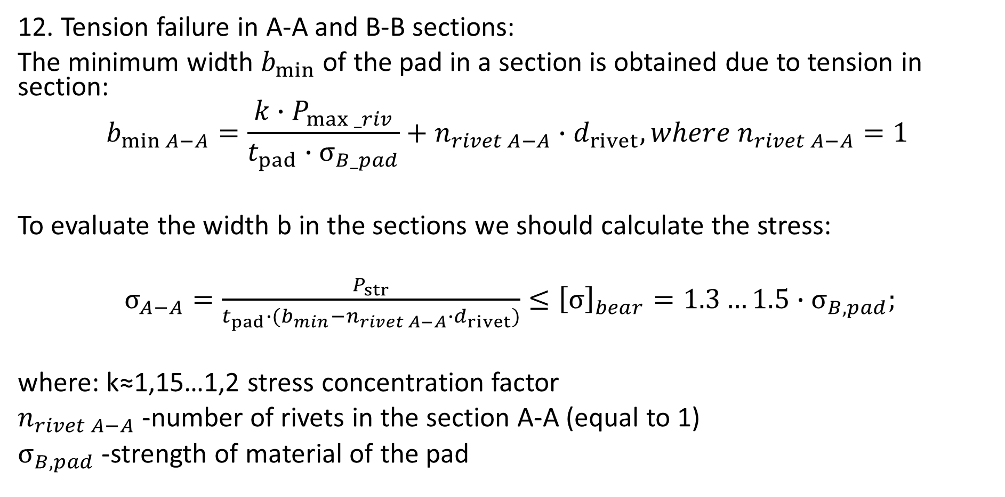
Task guide
12. Tension failure in A-A and B-B sections:
The minimum width $b_{min}$ of the pad in a section is obtained due to tension in section:
$$b_{\min{A−A}}=\frac{{k∙P}_{max⁡_riv}}{t_{pad}∙σ_{B_pad}}+n_{rivet A−A}∙d_{rivet}, where n_{rivet A−A}=1$$
To evaluate the width b in the sections we should calculate the stress:
$σ_{A−A}=\frac{P_{str}}{t_{pad}∙(b_{min}−n_{rivet A−A}∙d_{rivet})}≤{\left[σ\right]}_{bear}=1.3…1.5{∙σ}_{B,pad};$
where: k≈1,15…1,2 stress concentration factor
$n_{rivet A−A}$-number of rivets in the section A-A (equal to 1)
$σ_{B,pad}$-strength of material of the pad

Slide 11
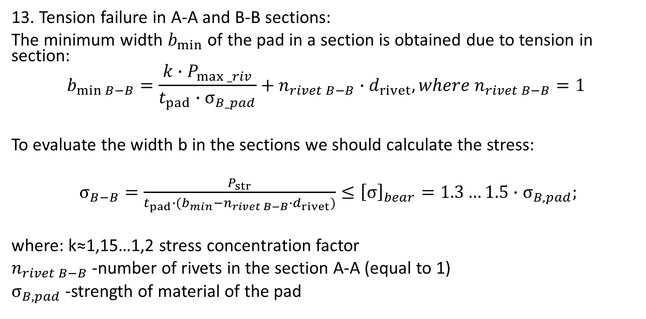
Task guide
13. Tension failure in A-A and B-B sections:
The minimum width $b_{min}$ of the pad in a section is obtained due to tension in section:
$$b_{\min{B−B}}=\frac{{k∙P}_{max⁡_riv}}{t_{pad}∙σ_{B_pad}}+n_{rivet B−B}∙d_{rivet}, where n_{rivet B−B}=1$$
To evaluate the width b in the sections we should calculate the stress:
$σ_{B−B}=\frac{P_{str}}{t_{pad}∙(b_{min}−n_{rivet B−B}∙d_{rivet})}≤{\left[σ\right]}_{bear}=1.3…1.5{∙σ}_{B,pad};$
where: k≈1,15…1,2 stress concentration factor
$n_{rivet B−B}$-number of rivets in the section A-A (equal to 1)
$σ_{B,pad}$-strength of material of the pad

Slide 12
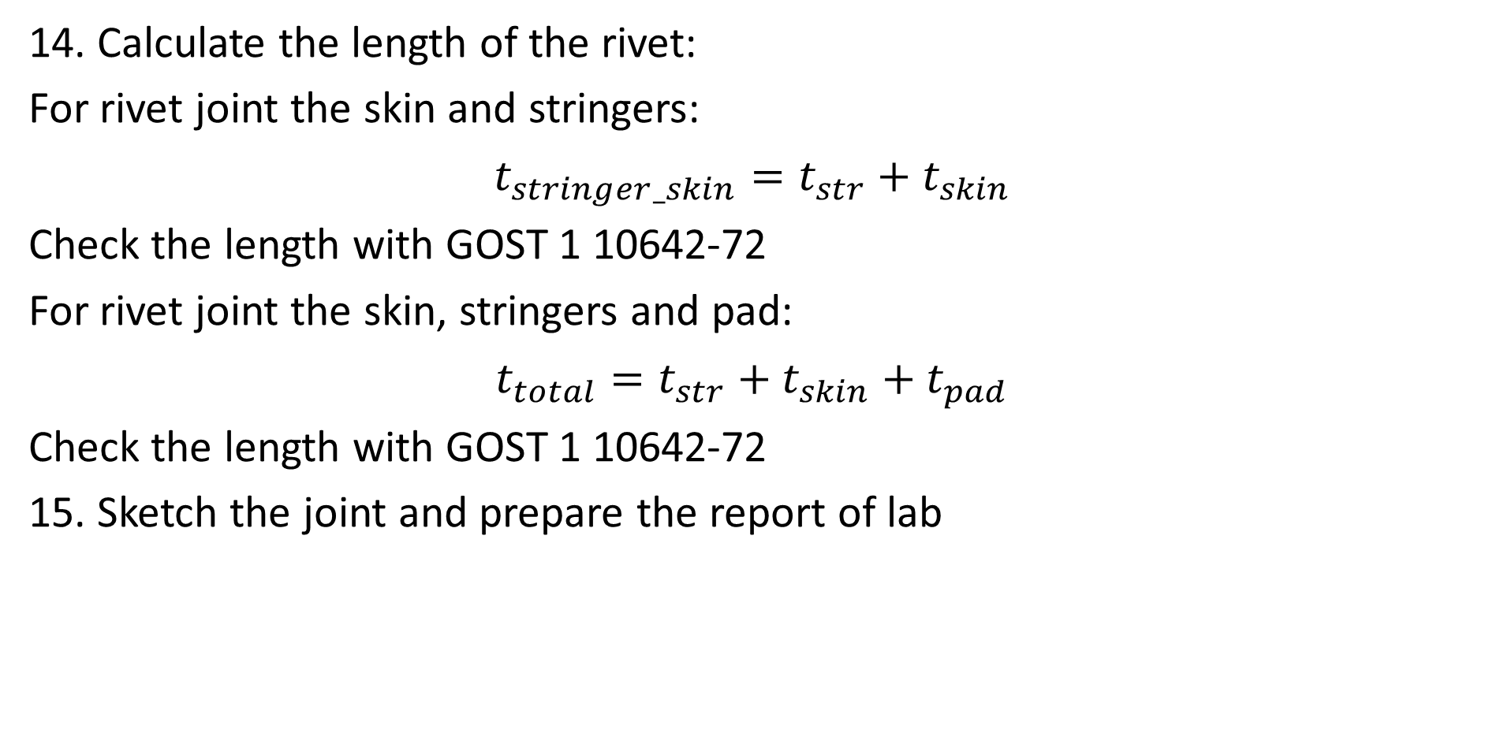
Task guide
14. Calculate the length of the rivet:
For rivet joint the skin and stringers:
$t_{stringer_skin}=t_{str}+$ $t_{skin}$
Check the length with GOST 1 10642-72
For rivet joint the skin, stringers and pad:
$t_{total}=t_{str}+$ $t_{skin}+t_{pad}$
Check the length with GOST 1 10642-72
15. Sketch the joint and prepare the report of lab

Slide 13
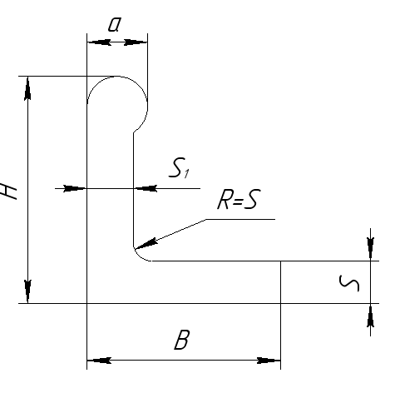
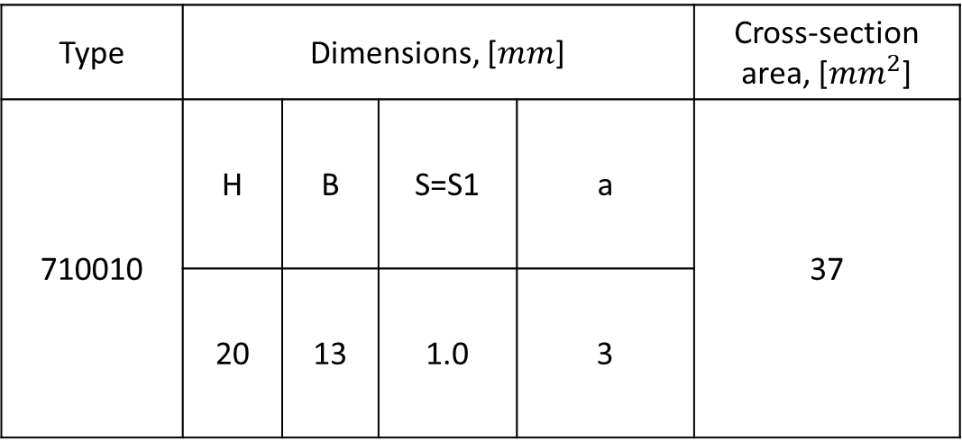
Task guide
Table – Variants-1
Type | Dimensions, [$mm$] |  |  |  | Cross-section area, [${mm}^{2}$]
710010 | H | B | S=S1 | a | 37
 | 20 | 13 | 1.0 | 3

Slide 14
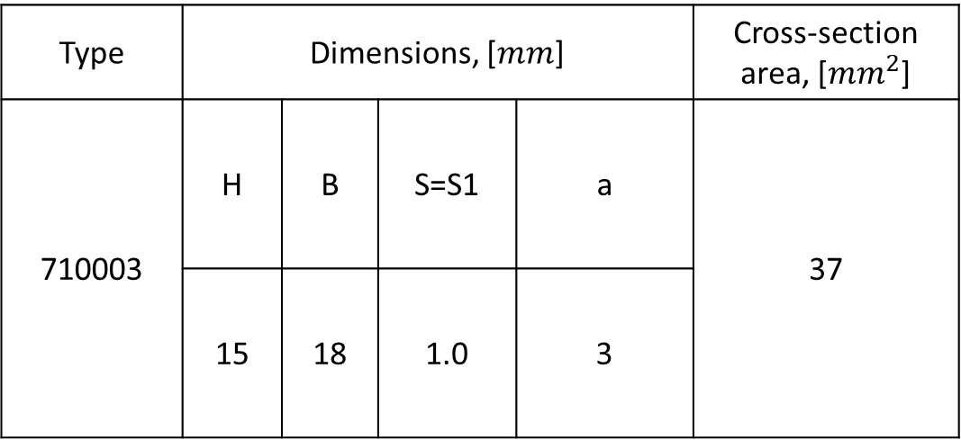
Task guide
Table – Variants-2
Type | Dimensions, [$mm$] |  |  |  | Cross-section area, [${mm}^{2}$]
710003 | H | B | S=S1 | a | 37
 | 15 | 18 | 1.0 | 3

Slide 15
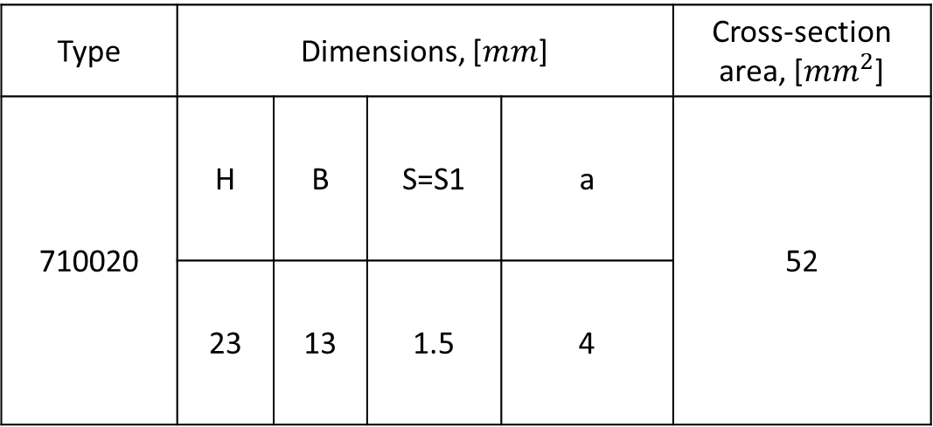
Task guide
Table – Variants-3
Type | Dimensions, [$mm$] |  |  |  | Cross-section area, [${mm}^{2}$]
710020 | H | B | S=S1 | a | 52
 | 23 | 13 | 1.5 | 4

Slide 16
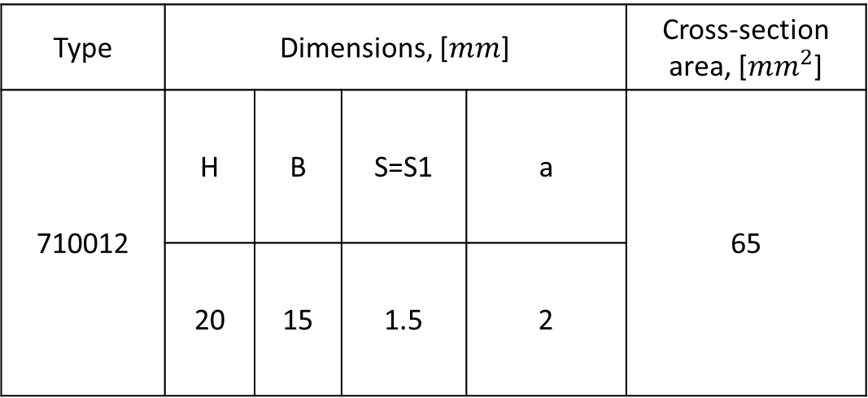
Task guide
Table – Variants-4
Type | Dimensions, [$mm$] |  |  |  | Cross-section area, [${mm}^{2}$]
710012 | H | B | S=S1 | a | 65
 | 20 | 15 | 1.5 | 2

Slide 17
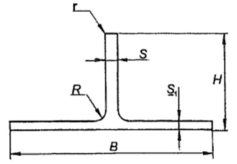
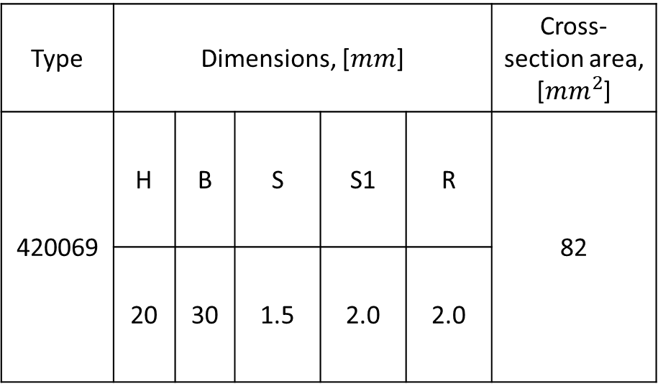
Task guide
Table – Variants-5
Type | Dimensions, [$mm$] |  |  |  |  | Cross-section area, [${mm}^{2}$]
420069 | H | B | S | S1 | R | 82
 | 20 | 30 | 1.5 | 2.0 | 2.0

Slide 18
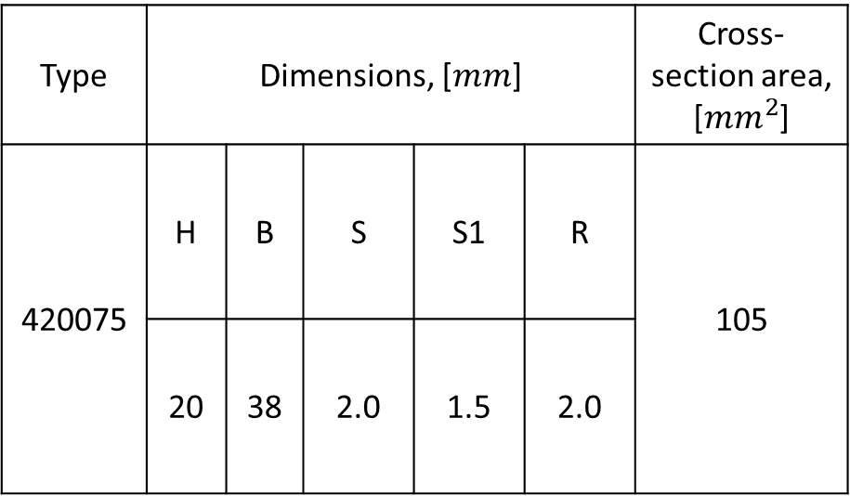
Task guide
Table – Variants-6
Type | Dimensions, [$mm$] |  |  |  |  | Cross-section area, [${mm}^{2}$]
420075 | H | B | S | S1 | R | 105
 | 20 | 38 | 2.0 | 1.5 | 2.0

Slide 19
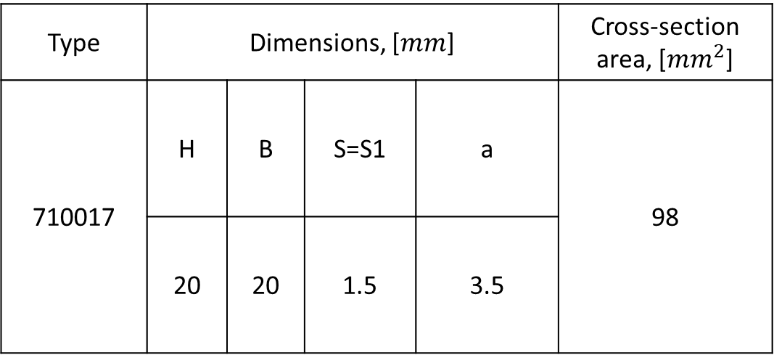
Task guide
Table – Variants-7
Type | Dimensions, [$mm$] |  |  |  | Cross-section area, [${mm}^{2}$]
710017 | H | B | S=S1 | a | 98
 | 20 | 20 | 1.5 | 3.5

Slide 20
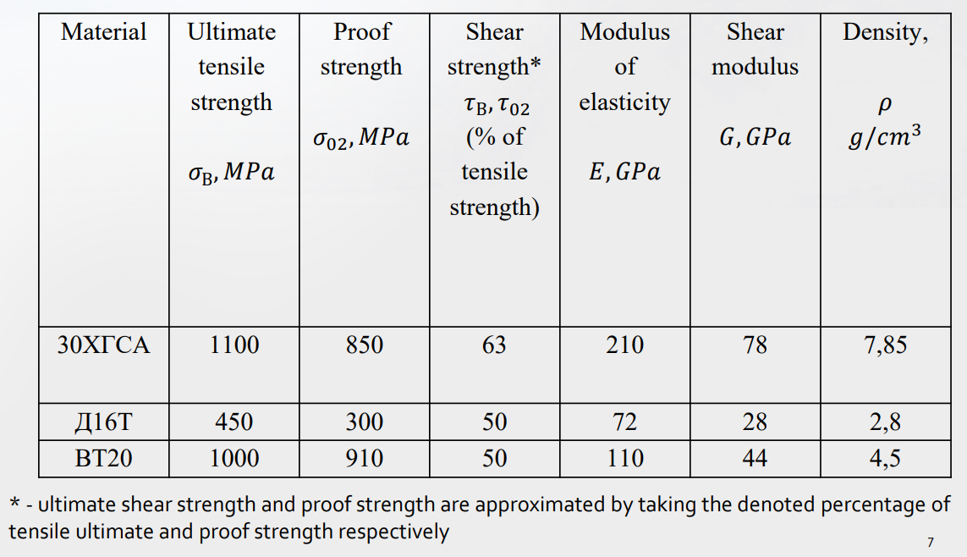
Task guide
Table – Material Properties

Slide 21

Task guide
Link for section data, variants and PPT

